Slide 1
sentiment analysis
CAPSTONE PROJECT
Presented By:
1. MUNI TEJASREE-NRI Institute of Technology-Information Technology

Slide 2
OUTLINE
Problem Statement
Proposed System/Solution
System Development Approach
Algorithm & Deployment
Result
Conclusion
Future Scope
References

Slide 3
Problem Statement
Develop a sentiment analysis model to classify reviews as positive or negative of a Restaurant.

Slide 4
Proposed Solution
The proposed system aims to address the challenge of Develop a sentiment analysis model to classify reviews as positive or negative of a Restaurant. This involves leveraging machine learning techniques to forecast demand patterns accurately. The solution will consist of the following components:
Data Collection:
Gather historical data on restaurant reviews, including reviews and liked.
Gather Restaurant Reviews: Collect a dataset of restaurant reviews. we can use online platforms like Yelp, Google Reviews, or specialized datasets available on platforms like Kaggle.
Data Preprocessing:
Text Cleaning: Remove special characters, punctuation, and numbers.
Tokenization: Split text into words or tokens.
Normalization: Convert text to lowercase to ensure uniformity.
Stopword Removal: Eliminate common words (e.g., "and", "the") that do not contribute to sentiment.
Machine Learning Algorithm:
Implement a machine learning algorithm, such as Naive Bayes Classifier is used to Fast to train and predict, works well with high-dimensional data like text.
Deployment:
Deploy the model in to classify new restaurant reviews into positive or negative sentiments.
Integrate the model into a web application or API where users can submit reviews and receive sentiment predictions in real-time.
Evaluation:
Evaluate the trained model using metrics such as accuracy, precision, recall, and F1-score on the validation set.
Perform error analysis to understand where the model performs well and where it struggles.

Slide 5
System Approach
To perform Sentiment analysis on the dataset 'Reviews.csv' and analyze customer behavior,
preferences, and satisfaction levels, you will need to set up a Python environment with the necessary libraries installed. Here are the system requirements and library requirements:
system requirements:
1.Hardware:
-A computer with sufficient processing power, and A multi-core processor is recommended to handle computations
efficiently, especially for large datasets. -Adequate RAM to handle the size of the dataset and computational requirements.
2.software:
The choice of operating system is flexible, as Python and necessary libraries are available on major platforms
including Windows, macOS, and Linux

Slide 6
System Approach-CONT-
library requirements:
-Scikit-learn
-nltk
-seaborn
-pandas
-matplotlib

Slide 7
Algorithm & Deployment
In the Algorithm section, describe the machine learning algorithm chosen for analysis reviews as positive or negative. Here's an example structure for this section:
Algorithm Selection:
Provide a brief overview of choosing algorithm is Naive Bayes assumes that features (words in this context) are conditionally independent given the class label. Despite this simplification often being unrealistic, Naive Bayes can perform well in practice for sentiment analysis tasks.
Pre Processing:
Before training, preprocess text data by removing stopwords, lowercasing, and stemming/lemmatizing words to improve model performance.
Training Process:
Fit the Naive Bayes classifier to the training data using libraries like scikit-learn and nltk which provides implementations for various Naive Bayes variants (e.g., Multinomial Naive Bayes for discrete features).
Prediction Process:
Evaluate the model's performance using metrics such as accuracy, precision, recall, and F1-score on a held-out validation set.

Slide 8
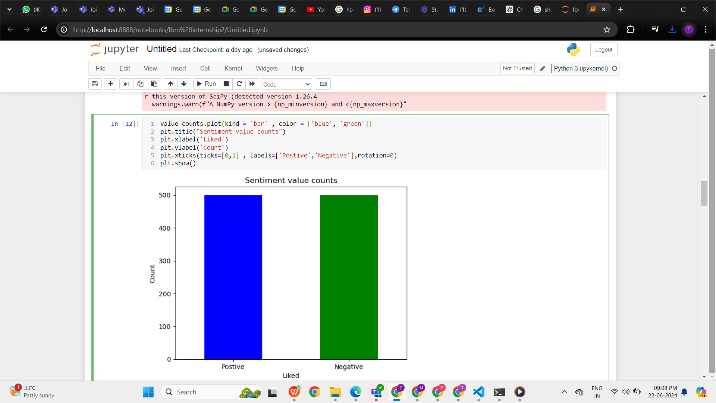
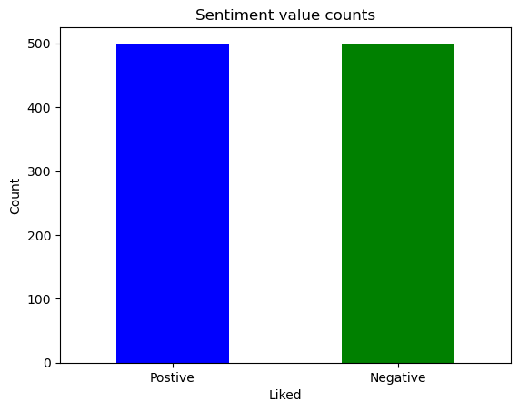
Result
It uses a bar chart to display counts of positive and negative sentiments (1 for Positive, 0 for Negative), illustrating the frequency of each sentiment category clearly labeled as "Positive" and "Negative."

Slide 9
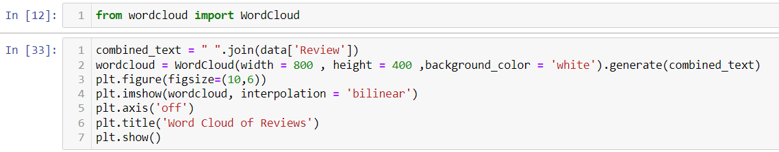
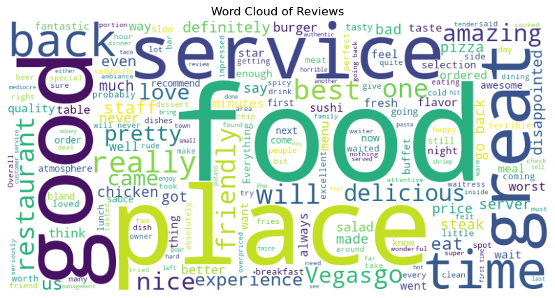
This visualization creates a word cloud from restaurant reviews in the data DataFrame, combining all text into a single string. The WordCloud is set to a size of 800 by 400 pixels with a white background. It vividly depicts the most frequent words in the reviews, providing a visual summary of the most commonly mentioned aspects.

Slide 10
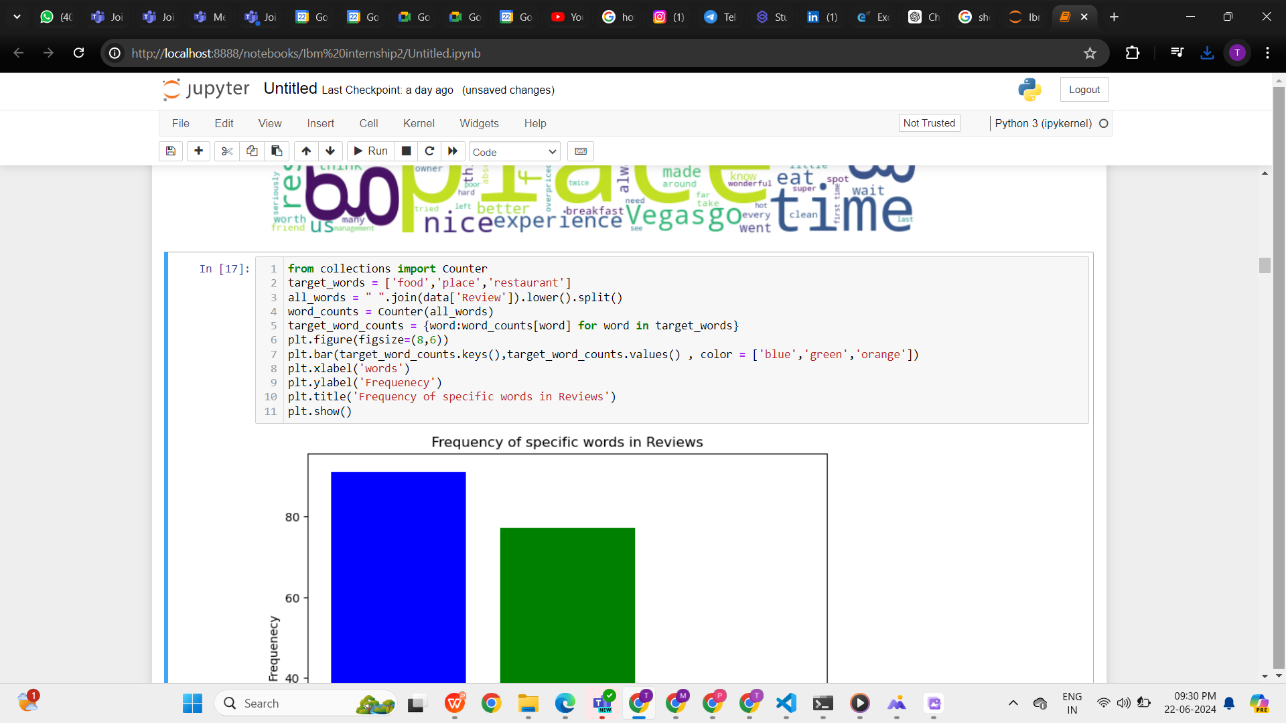
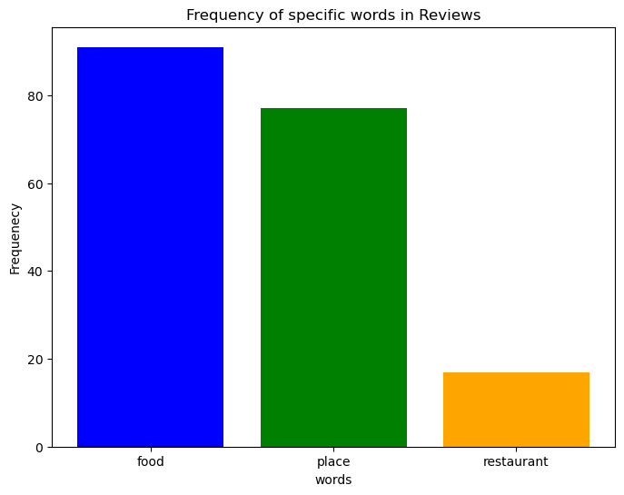
This bar chart visualizes the frequency of specific words—"food," "place," and "restaurant"—in restaurant reviews from the data DataFrame. Each bar's height represents how frequently each word appears in the reviews, with colors distinguishing between the words for clarity

Slide 11
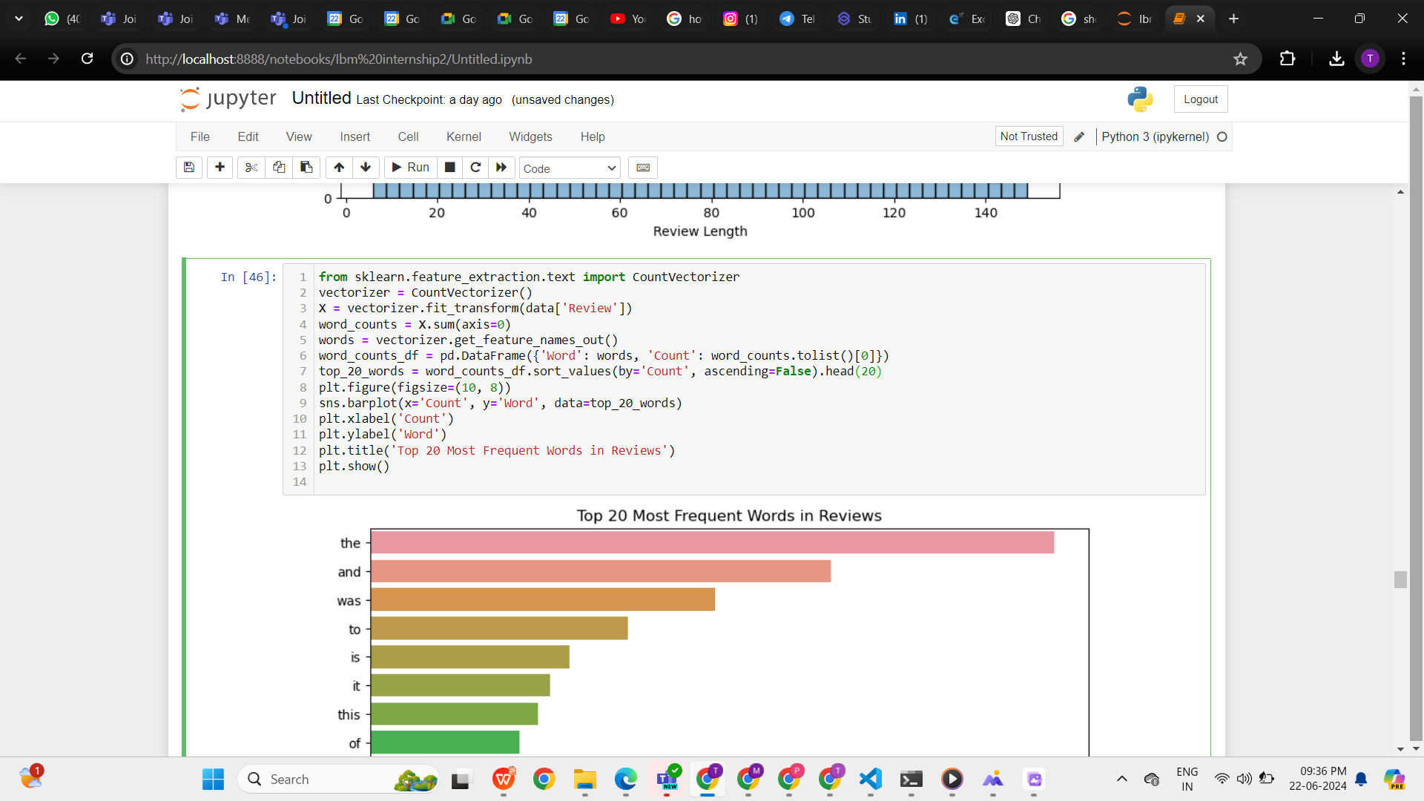
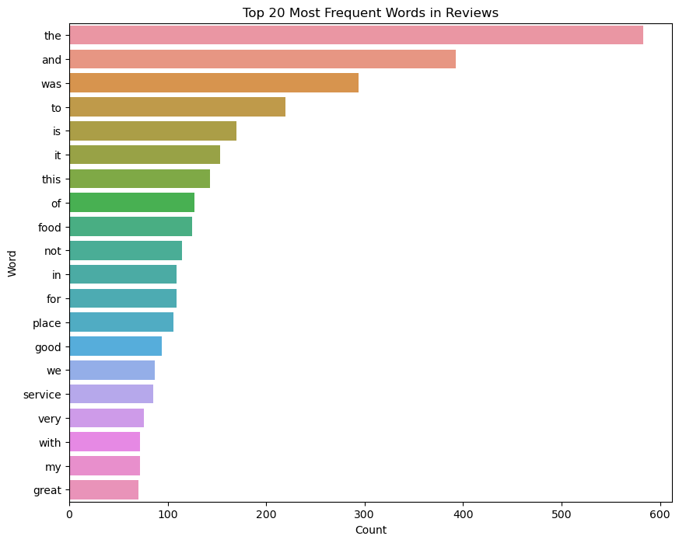
This plot showcases the top 20 most frequent words extracted from restaurant reviews using CountVectorizer from sklearn. Each bar's height represents the frequency of occurrence for a specific word, offering insights into the common topics and themes expressed in the reviews.

Slide 12
Conclusion
The development of a sentiment analysis model to classify restaurant reviews as positive or negative has provided valuable insights into customer perceptions. By leveraging natural language processing techniques and machine learning algorithms on the reviews.csv dataset. This analysis provides a clearer understanding of customer sentiments and preferences, which can be valuable for enhancing service quality and customer satisfaction strategies in the restaurant industry.

Slide 13
Future scope
The future scope for the sentiment analysis project focused on restaurant reviews using the reviews.csv dataset includes several potential avenues for further development and enhancement:
Fine-grained Sentiment Analysis: Expand the model to perform more nuanced sentiment analysis, distinguishing between positive, negative, and neutral sentiments. This could involve sentiment intensity analysis or aspect-based sentiment analysis to capture varying degrees of sentiment within different aspects of restaurant experiences (e.g., food quality, service, ambiance).
Real-time Monitoring and Feedback: Develop mechanisms to monitor reviews and feedback in real-time, allowing restaurants to promptly respond to customer concerns or issues raised in reviews. This could involve integrating the model with live data streams from review platforms or social media.
Personalization and Customer Segmentation: Utilize clustering and segmentation techniques to group customers based on their review sentiments and preferences. This could support personalized marketing strategies and tailored customer engagement initiatives.
Integration with Business Intelligence Tools: Integrate the sentiment analysis insights with business intelligence tools and dashboards, providing stakeholders with interactive visualizations and actionable insights for informed decision-making.
Sentiment Trend Analysis: Implement techniques for analyzing sentiment trends over time to identify patterns and changes in customer sentiment towards the restaurant. This could help predict long-term customer satisfaction trends and anticipate shifts in consumer preferences.
Enhanced Model Performance: Continuously optimize the sentiment analysis model by experimenting with different machine learning algorithms, feature engineering techniques, and model hyperparameters to improve accuracy and robustness.
Feedback Loop for Continuous Improvement: Establish a feedback loop where insights from sentiment analysis are used to inform and optimize restaurant operations, marketing strategies, and customer service initiatives, fostering continuous improvement in customer satisfaction and business performance.
By exploring these future directions, the sentiment analysis project can evolve from a basic classification task into a comprehensive tool for understanding and improving customer experiences in the restaurant industry.

Slide 14
References
References for a sentiment analysis project focusing on restaurant reviews can include online resources, and relevant software documentation. Here are some examples of potential references you could cite:
Documentation and tutorials from libraries and frameworks used in my sentiment analysis, such as scikit-learn, NLTK (Natural Language Toolkit), matplotlib, etc.
Scikit-learn Documentation: https://scikit-learn.org/stable/documentation.html
NLTK (Natural Language Toolkit) Documentation: https://www.nltk.org/
Kaggle: https://www.kaggle.com/
Documentation for tools and libraries used in data preprocessing, feature extraction, model training, and evaluation.
Official documentation for sentiment analysis APIs or platforms if you used any.

Slide 15
THANK YOU

